Slide 1

University Management System
Team #10
20113334 신재훈
20111084 송민석
20111466 안재혁

Slide 2
Contents
University Management System
1. What?
2. How?
3. Demo?

Slide 3
1. What - Preview
This is University Management System
We use Java
-awt/swing, File I/O

Slide 4
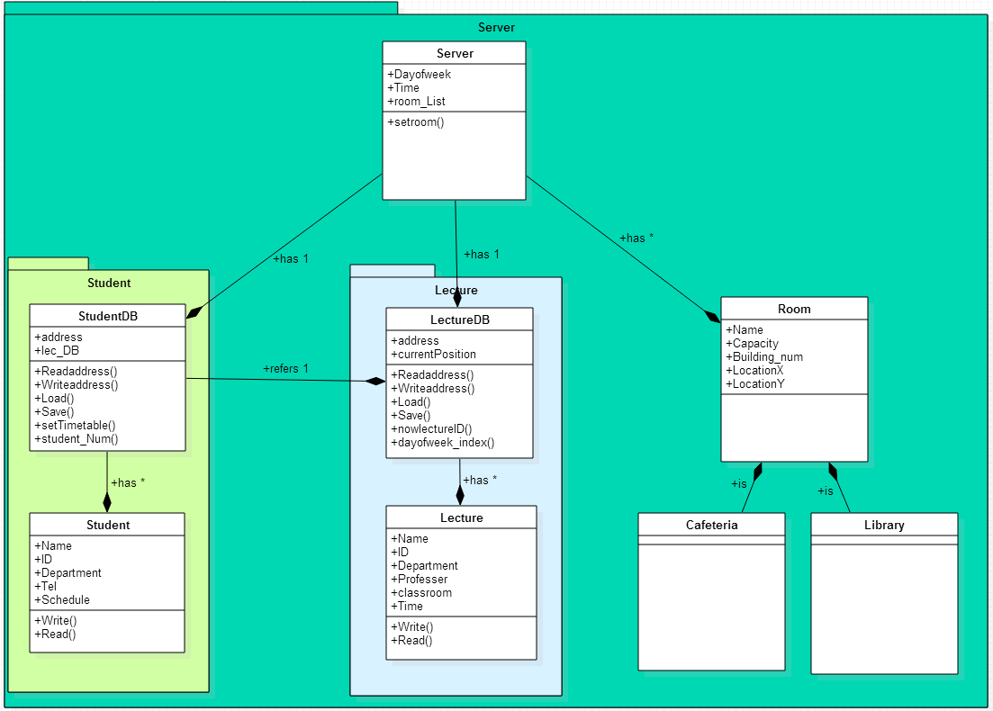
2. How - Diagram

Slide 5
2. How - class
Server
StudentDB
Student
lectureDB
lecture
Room - Cafeteria
- Library

Slide 6
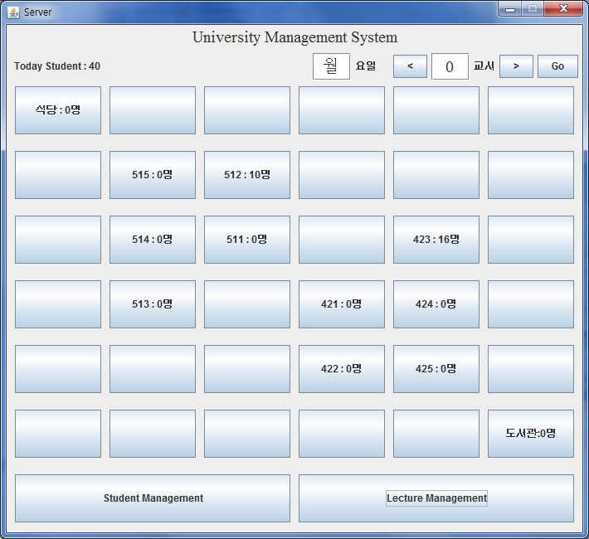
2. How - class
Server
- main class
- has StudentDB, lectureDB,
and many Rooms
- show map

Slide 7
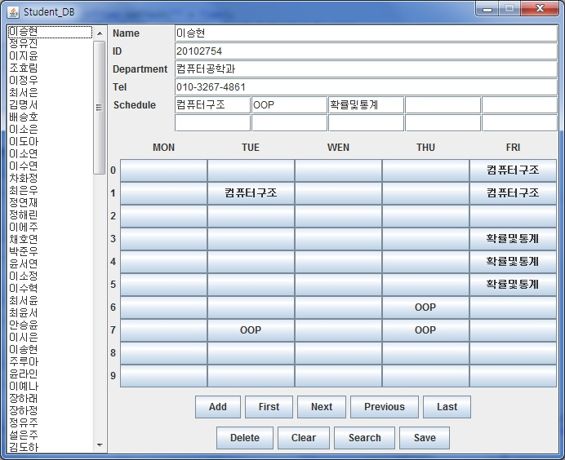
2. How - class
StudentDB
Student
-File I/O
-use lectureDB, lecture
make timetable

Slide 8
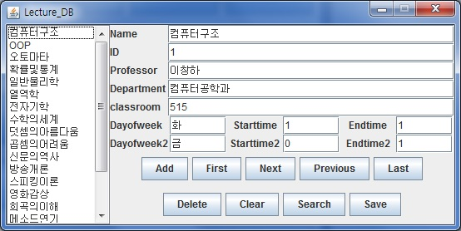
2. How - class
lectureDB
Lecture
-File I/O

Slide 9
2. How - class
Room - Cafeteria
- Library

Slide 10
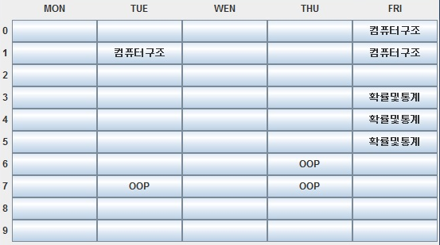
2. How - Implementation
setTimetable() [StudentDB]
- check lectureDB

Slide 11
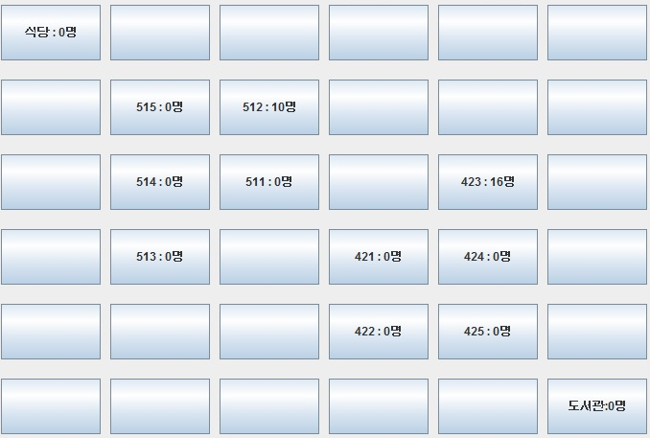
2. How - Implementation
setRoom() [Server]
- student_Num() [StudentDB]
- nowlectureID() [lectureDB]
- today_StuNum [StudentDB]
- goHome_StuNum [StudentDB]

Slide 12
3. Demo

Slide 13
Thank you!

